Slide 1

SQL - 3
Gerry Guinane
Limerick Institute of Technology
Topic 3 SQL Lecture 03

Slide 2
Learning outcomes
Learning outcomes – the student will be able to
Use the following SQL statements – DELETE,INSERT,UPDATE
Distinguish between the different classes of SQL command – DML,DDL,DCL,TCL,DAC

Slide 3
Delete Syntax
Deletes a record or set of records from one or more tables.
Syntax
DELETE [LOW_PRIORITY] [QUICK] [IGNORE]
FROM tbl_name
[WHERE where_condition]
[ORDER BY ...]
[LIMIT row_count]

Slide 4
Syntax Parts
For the single-table syntax, the DELETE statement deletes rows from tbl_name and returns the number of rows deleted.
The WHERE clause, if given, specifies the conditions that identify which rows to delete.
With no WHERE clause, all rows are deleted.
If the ORDER BY clause is specified, the rows are deleted in the order that is specified.
The LIMIT clause places a limit on the number of rows that can be deleted.

Slide 5
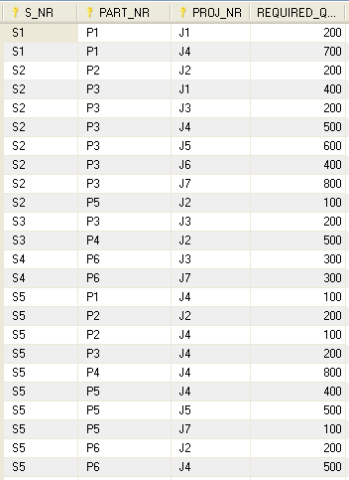
Delete Example
Example
DELETE FROM `parts`.`project_parts_required`
WHERE
S_NR='S1'
AND PART_NR='P1'
AND PROJ_NR='J1';0));

Slide 6
Insert Syntax
Inserts (appends) DATA into a TABLE
INSERT statement allows you to insert one or more rows to the table.

Slide 7
INSERT Syntax:
INSERT INTO target [(field1[, field2[, ...]])]
VALUES (value1[, value2[, ...])
Inserts a new data row into an existing table by specifying the column name and data for each.

Slide 8
INSERT Syntax:
INSERT
[LOW_PRIORITY | HIGH_PRIORITY] [IGNORE]
[INTO] tbl_name [(col_name,...)]
SELECT ... [ ON DUPLICATE KEY UPDATE col_name=expr, ... ]
In the second form, instead of providing explicit data, you select it from other table by using SELECT statement. This form allows you to copy some or some part of data from other table to the inserted table

Slide 9
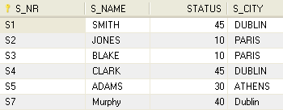
INSERT Example 1
Query
Result
Record added to S table
Insert into suppliers
Values ('S7','Murphy','40', 'Dublin');
Notes
This SQL statement uses SINGLE record Append:
INSERT INTO target [(field1[, field2[, ...]])]
VALUES (value1[, value2[, ...])

Slide 10

INSERT Example 2
Query
Result
INSERT INTO top_suppliers
SELECT
suppliers.S_NR, suppliers.S_NAME, suppliers.STATUS, suppliers.S_CITY
FROM suppliers WHERE suppliers.STATUS<30;
Record added to top_suppliers table
Notes
This SQL statement uses MULTIPLE record Append.
See notes page for CREATE TABLE statement
Notes:
CREATE TABLE `top_suppliers`
( `SUPPLIER_NR` varchar(45) NOT NULL,
`NAME` varchar(45) NOT NULL,
`STAT` int(10) unsigned NOT NULL,
`CITY` varchar(45) NOT NULL,
PRIMARY KEY (`SUPPLIER_NR`))
ENGINE=InnoDB DEFAULT CHARSET=latin1;

Slide 11
Update
SQL UPDATE statement is used to update existing data in database tables. It can be used to change values of single row, group of rows or even all rows in a table. In MySQL, the SQL UPDATE statement form is as below:
UPDATE [LOW_ PRIORITY] [IGNORE]
table_name [, table_name...]
SET column_name1=expr1
[, column_name2=expr2 ...]
[WHERE condition]
Note: IGNORE keyword is used to execute the update even errors occurred during the execution. The errors in the update process could be duplicate value on unique column, or new data does not match with the column data type. In the first situation data is not updated and in the second one MySQL tries to convert the data into closest valid values.

Slide 12
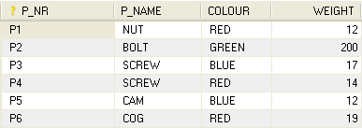
Update
Query
Result
UPDATE
parts.parts
SET weight=200
WHERE P_NR='P2'

Slide 13
Delete
The DELETE statement not only allows you to delete record from one table but also multiple tables

Slide 14
Delete
DELETE [LOW_PRIORITY] [QUICK]
FROM table_name
[WHERE conditions] [ORDER BY ...] [LIMIT rows]
The WHERE clause specifies condition to limit which rows you want to to remove.
If a record meets WHERE condition, it will be removed from the database table permanently.
If the WHERE clause is not used in the MySQL DELETE statement, all rows of the table are deleted providing the DBMS is not in MySQL Safe Mode

Slide 15
MySQL Safe Mode
sql_safe_updates : If set to 1, MySQL aborts UPDATE or DELETE statements that do not use a key in the WHERE clause or a LIMIT clause.
Specifically, UPDATE statements must have a WHERE clause that uses a key or a LIMIT clause, or both. DELETE statements must have both.
This makes it possible to catch UPDATE or DELETE statements where keys are not used properly and that would probably change or delete a large number of rows.
The default value is 0.
To view the current value – enter
SHOW VARIABLES;
To disable Safe mode – enter on command line:
SET SQL_SAFE_UPDATES=0;
https://dev.mysql.com/doc/refman/5.0/en/server-system-variables.html
https://dev.mysql.com/doc/refman/5.0/en/show-variables.html

Slide 16

Delete
Query
Result
DELETE FROM top_suppliers
WHERE SUPPLIER_NR='S2';

Slide 17
Types of SQL command
DDL - Data Definition Language/Statements
DCL – Data Control Language/Statements
DML – Data Manipulation Language/Statements
Data Administration Commands/Statements
Transactional Control Commands/Statements

Slide 18
DDL - Data Definition Language/Statements
Purpose: DDL is abbreviation of Data Definition Language. DDL, is the part of SQL that allows a database user to create and restructure database objects, such as the creation or the deletion of a table
Examples: CREATE, ALTER, DROP statements

Slide 19
DML – Data Manipulation Language/Statements
Purpose:DML is abbreviation of Data Manipulation Language. It is used to retrieve, store, modify, delete, insert and update data in database.
Examples: SELECT, UPDATE, INSERT statements

Slide 20
DCL – Data Control Language/Statements
Purpose: DCL is abbreviation of Data Control Language. It is used to create roles, permissions, and referential integrity as well it is used to control access to database by securing it.
Data control commands in SQL allow you to control access to data within the database. These DCL commands are normally used to create objects related to user access and also control the distribution of privileges among users.
Examples: GRANT, REVOKE statements

Slide 21
Data Administration Commands/Statements
Purpose:Data administration commands allow the user to perform audits and perform analyses on operations within the database. They can also be used to help analyze system performance.
Examples: START AUDIT, STOP AUDIT

Slide 22
Transactional Control Commands/Statements
Purpose:TCL is abbreviation of Transactional Control Language. It is used to manage different transactions occurring within a database.
Examples: COMMIT, ROLLBACK statements

